Slide 1
Serverless Applications AWS Lambda

Slide 2
Outline
Overview of Serverless
Serverless Architectures
AWS Lambda Example Architecture
Overview of Containers
Container Architectures
Where we go from here
AWS Lambda + AWS API Gateway

Slide 3
Need for Virtual Machines
The Issue
Deployment of server applications is getting complicated since software can have many types of requirements.
The Solution
Run each individual application on a separate virtual machine.
Virtualization
Offers a hardware abstraction layer that can adjust to the specific CPU, memory, storage and network needs of applications on a per server basis.

Slide 4
Virtual Machines are expensive
The Problems with Virtual machines
Money – You need to predict the instance size you need. You are charged for every CPU cycle, even when the system is “running its thumbs”
Time – Many operations related to virtual machines are typically slow
The Solution
Serverless Architectures
Containers
Containers
Operating System Level virtualization, a lightweight approach to virtualization that only provides the bare minimum that an application requires to run and function as intended.

Slide 5
What is Serverless?
Serverless architectures refer to applications that significantly depend on third party-services (known as Backend as a Service or “Baas”) or on custom code that’s run in ephemeral containers (Function as a Service or “FaaS”), the best known vendor host of which currently is AWS Lambda. By using these ideas, and by moving much behavior to the front end, such architectures remove the need for the traditional ‘always on’ server system sitting behind an application.
“No server is easier to manage than no server” – Werner Vogels
Note: slides provided by Nate Slater, Senior Manager AWS Solutions Architecture, “State of Container and Serverless Architectures”

Slide 6
Features of Serverless Architectures
No compute resource to manage
Provisioning and scaling handled by the service itself
You write code and the execution environment is provided by the service
Core functionality (e.g. database, authentication and authorization) is provided by at-scale Web Services

Slide 7
The origins of “Functions-as-a-Service”
AWS Lambda – Announced at re:Invent 2014. First web service of it’s kind that completely abstracted the execution environment from the code
API Gateway – Launched in mid-2015. Critical ingredient for building service endpoints with Lambda.
Combined with existing back-plane services like DynamoDB, Cloudformation, and S3 and “serverless” development was born.

Slide 8
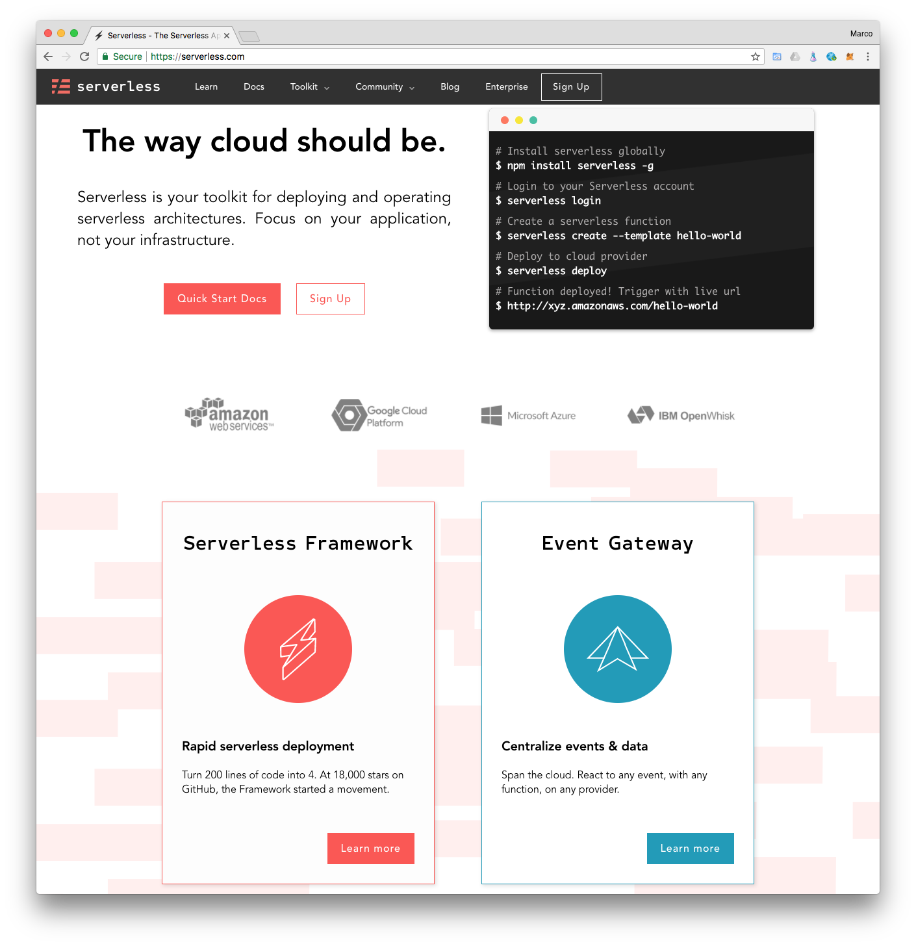
The FaaS Development Framework Ecosystem
Serverless Framework (serverless.com)
Open source framework for building serverless applications with AWS Lambda, Microsoft Azure and IBM OpenWhisk and Google Cloud Functions
Supports node.js, python, and java
Chalice
Python based framework for microservice development with AWS Lambda
Apex
A set of tools written in Go to manage serverless deployments to AWS Lambda
• Serverless Application Module (SAM)
AWS framework that extends CloudFormation (common language to describe and provision infrastructure resources in the cloud)

Slide 9
FaaS – How Does it Work?
You write a function and deploy it to the cloud service for execution.
Example: node.js with AWS Lambda:
module.exports.handler = function(event, context, callback) {
console.log("event: " + JSON.stringify(event));
if ((!event.hasOwnProperty("email") || !event.hasOwnProperty("restaurantId")) || (!event.email || !event.restaurantId)) { callback("[BadRequest] email and restaurantId are required");
return; }
}

Slide 10
BaaS - Backend-as-a-Service
Data Stores
NoSQL Databases
BLOB Storage
Cache (CDN)
Analytics
Query
Search
IoT
Stream Processing
AI
Machine Learning
Image Recognition
Natural Language Processing/Understanding
Speech to Text/Text to Speech

Slide 11
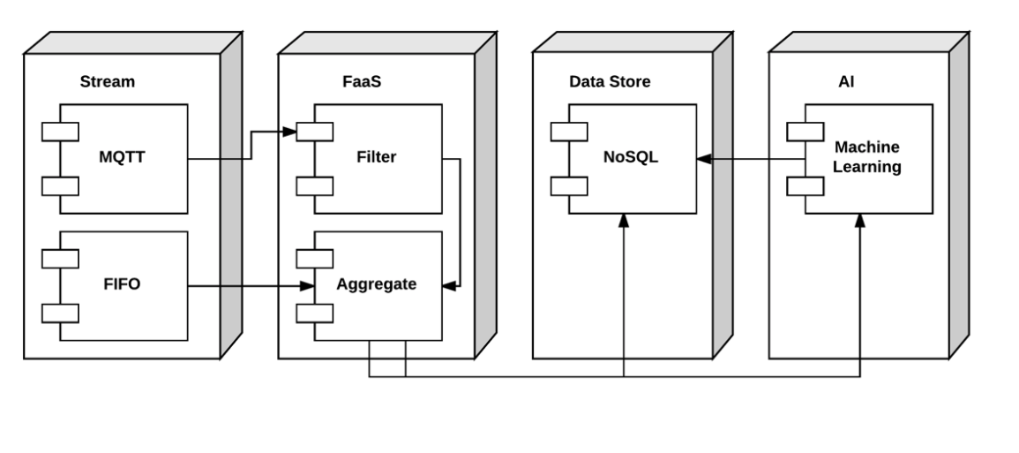
Serverless Architecture – Stream Analytics/IoT

Slide 12
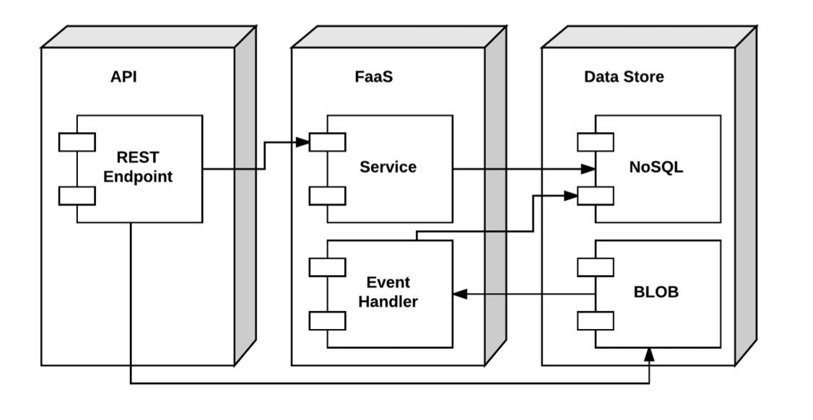
Serverless Architecture - Microservices

Slide 13
AWS Lambda Example Architecture
Search
Location-Awareness
Machine-learning powered recommendations
NoSQL
Microservices
API Management
Static website with CDN
Not a single server to manage!

Slide 14
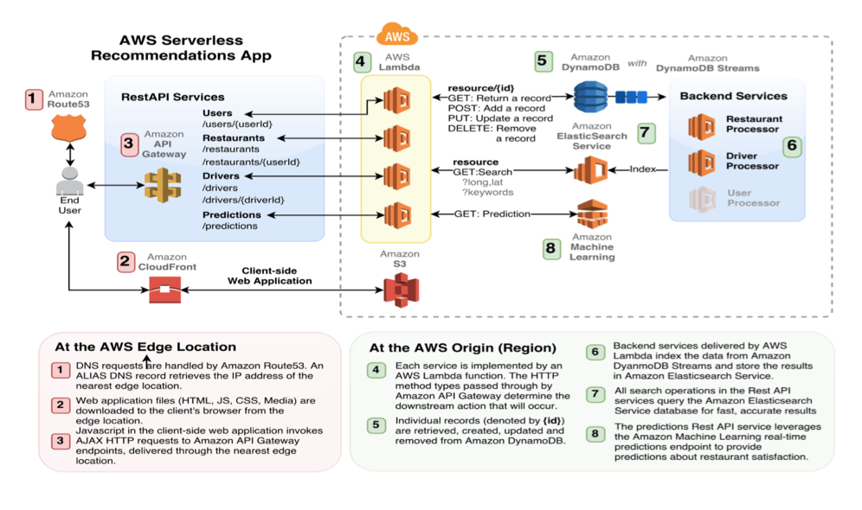
AWS Lambda Example Architecture (cont’d)

Slide 15
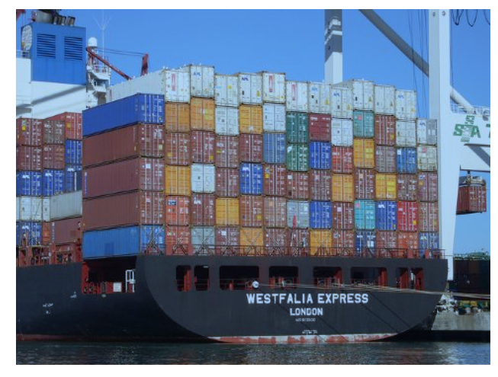
What are Containers?
Virtualization at the OS level
Based on Linux kernel features
cgroups
namespaces
Concept has been around for a while
Solaris ”zones” – early form of containerization
LXC – Early form of containerization on Linux
Docker has brought containers mainstream

Slide 16
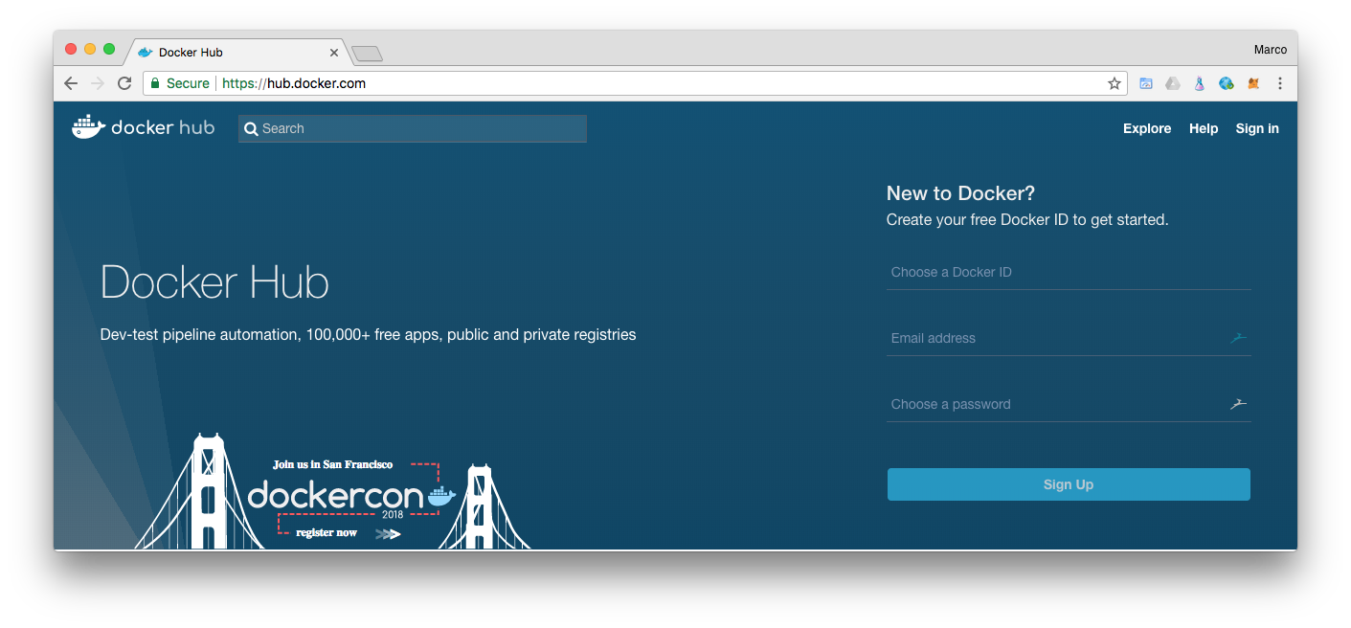
Containers – Key Features
Lightweight
All containers running on the same host share a single Linux kernel
Container images don’t require a full OS install like a virtual machine image
Portable
Execution environment abstracts the underlying host from the container
No dependency on a specific virtual machine technology
Container images can be shared using GitHub-like repositories, such as DockerHub (hub.docker.com)

Slide 17
Docker
Docker is a tool that allows developers, sys-admins etc. to easily deploy their applications in a sandbox (called containers) to run on the host operating system i.e. Linux.
Key Benefit : Allows users to package an application with all of its dependencies into a standardized unit for software development.
Unlike virtual machines, Containers do not have the high overhead and hence enable more efficient usage of the underlying system and resources.
Allow extremely higher efficient sharing of resources
Provides standard and minimizes software packaging
Decouples software from underlying host w/ no hypervisor
Container Issues
Security
Less Flexibility in Operating Systems, Networking
Management of Docker and Container in production is challenge

Slide 18
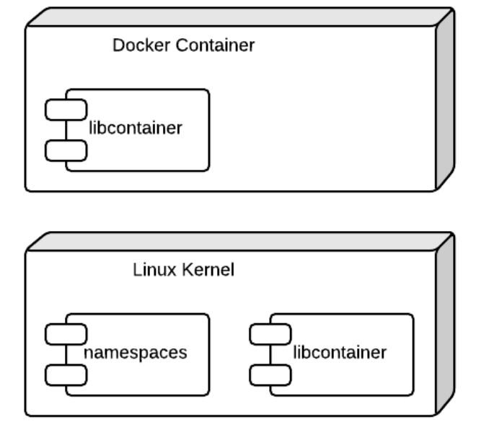
Docker Runtime Architecture

Slide 19
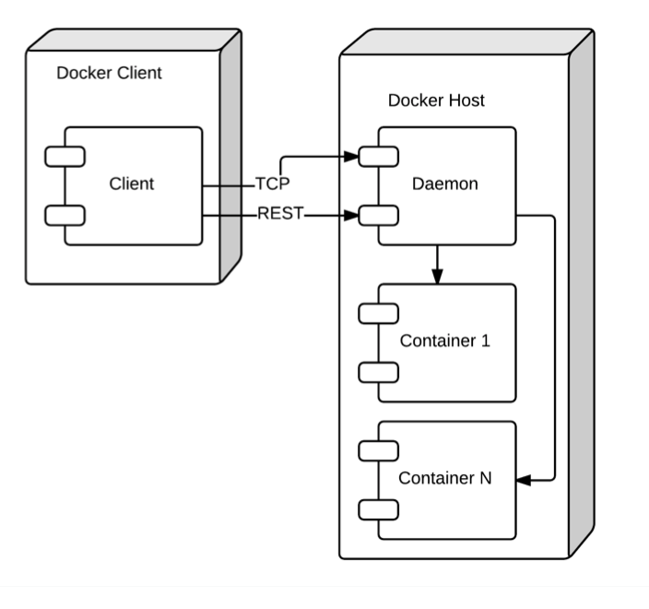
Docker – Platform Architecture

Slide 20
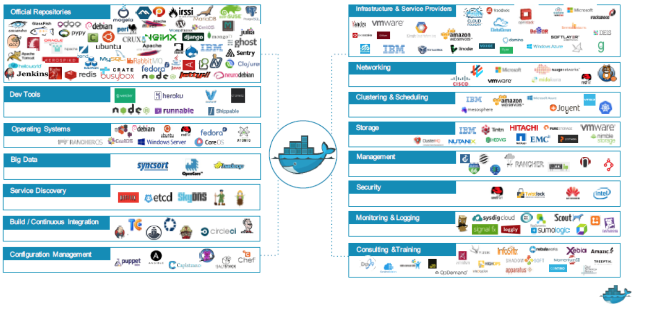
The Docker Ecosystem

Slide 21
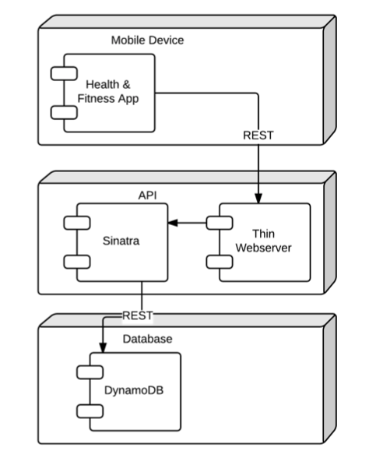
Container-Based Microservice Example
Sinatra is a lightweight web application library and domain-specific language that provides a faster and simpler alternative to Ruby frameworks such as Ruby on Rails. See: https://github.com/sinatra/sinatra/

Slide 22
Serverless – Where we go from here
Backend-as-a-Service
AI
Fraud detection
Latent sematic analysis
Geospatial
Satellite imagery
Hyper-Locality
Analytics
Query
Search
Stream Processing
Database
Graph
HPC (High Performance Computing)

Slide 23
Serverless – Where we go from here (cont’d)
Function-as-a-Service
Polyglot language support (each function written in a different language)
Stateful endpoints (Web Sockets)
Remote Debugging
Enhanced Monitoring
Evolution of CI/CD Patterns (Continuous Integration / Continuous Depoyment)
IDE’s
See “Ten Attributes of Serverless Computing Platforms”:
https://thenewstack.io/ten-attributes-serverless-computing-platforms/

Slide 24
Containers – Where we go from here
Networking
Overlay networks between containers running across separate hosts
Stateful Containers
Support for container architectures that read and write persistent data
Monitoring and Logging
Evolution of design patterns for capturing telemetry and log data from running containers
Debugging
Attach to running containers and debug code
Security
Better isolation at the kernel level between containers running on the same host
Secret/Key management – Transparently pass sensitive configuration

Slide 25
AWS Lambda
Compute Service using Amazon's infrastructure
Code === function
Supported – Java, Python and Node.js (i.e. JavaScript)
Can say it to be Docker under the covers
A system that uses Linux Containers
Pay only for the compute time you use
Triggered by events or called from HTTP
It still has SERVERS but we do not care about them
Functions are unit of deployment and scaling
No Machines, No Vms or containers visible in Programming Model
Never pay for idle
AutoScaling and Always Available, adapts to rate of incoming requests

Slide 26

Using AWS Lambda
No Servers to Manage
Continuous Scaling
Subsecond metering
Bring your own code
Simple resource model
Flexible Authorization and Use
Stateless but you can connect to others to store state
Authoring functions
Makes it easy to
Perform real time data processing
Build scalable backend services
Glue and choreograph systems

Slide 27
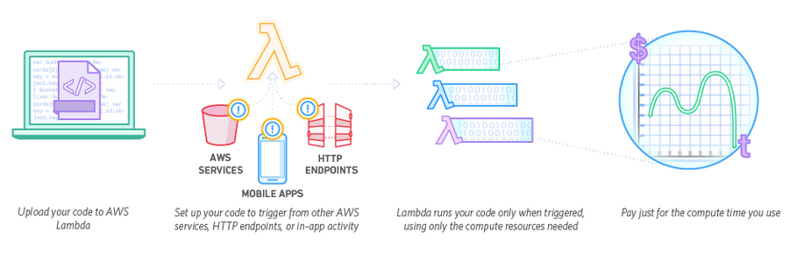
AWS Lambda - How It Works

Slide 28
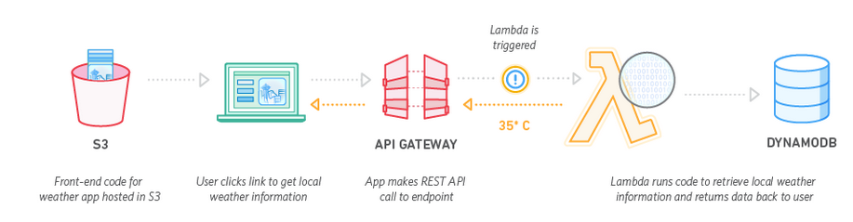
AWS Lambda - How It Works (cont’d)

Slide 29
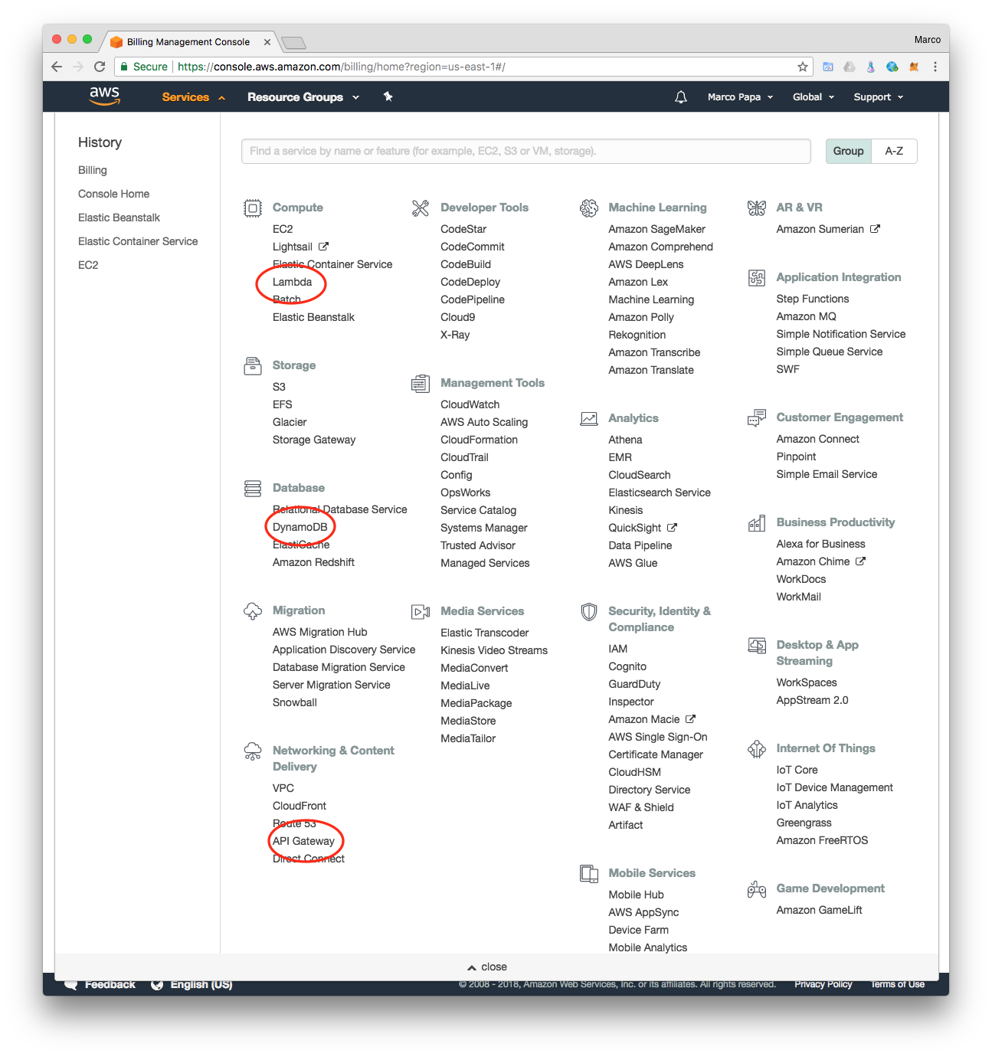
Amazon API Gateway
Amazon API Gateway is a fully managed service that makes it easy for developers to create, publish, maintain, monitor, and secure APIs at any scale.
Creates a unified API front end for multiple microservices
DDos Protection and throttling for back end systems
Authenticate and authorize requests

Slide 30
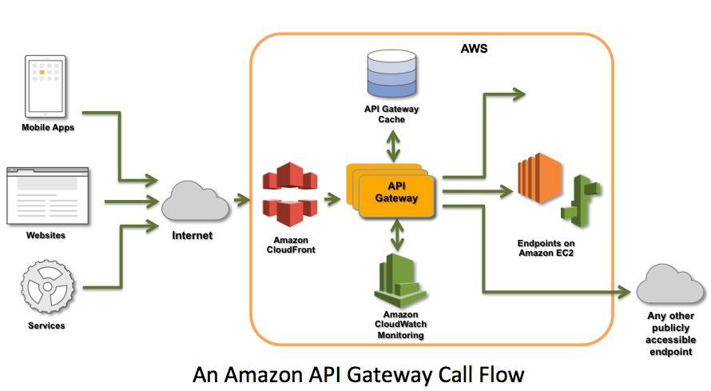
Amazon API Gateway Call Flow

Slide 31
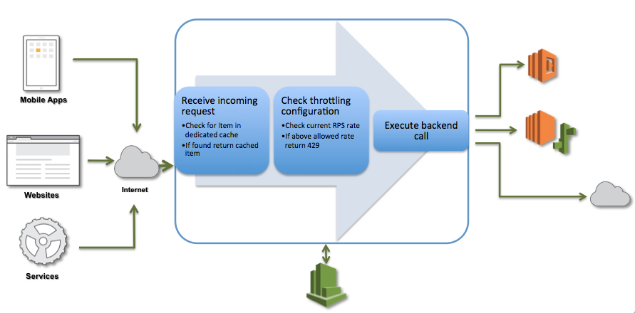
Amazon API Gateway Request Processing Workflow

Slide 32
AWS Lambda Supported Event Sources
Amazon S3
Amazon DynamoDB
Amazon Kinesis Streams
Amazon Simple Notification Service
Amazon Simple Email Service
Amazon Cognito
AWS CloudFormation
Amazon CloudWatch Logs
Amazon CloudWatch Events
AWS CodeCommit
Scheduled Events (powered by Amazon CloudWatch Events)’
AWS Config
Amazon Echo
Amazon Lex
Amazon API Gateway
See: http://docs.aws.amazon.com/lambda/latest/dg/invoking-lambda-function.html

Slide 33
Create a Simple Microservice using Lambda and API Gateway
In this exercise you will use the Lambda console to create a Lambda function (MyLambdaMicroservice), and an Amazon API Gateway endpoint to trigger that function. You will be able to call the endpoint with any method (GET, POST, PATCH, etc.) to trigger your Lambda function. When the endpoint is called, the entire request will be passed through to your Lambda function. Your function action will depend on the method you call your endpoint with:
DELETE: delete an item from a DynamoDB table
GET: scan table and return all items
POST: Create an item
PUT: Update an item

Slide 34
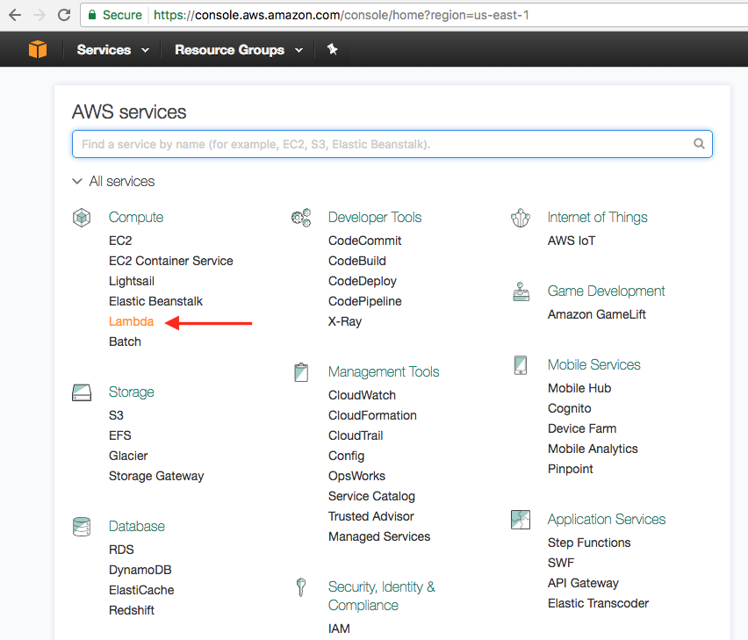
AWS Lambda (cont’d)
Follow the steps in this section to create a new Lambda function and an API Gateway endpoint to trigger it:
Sign in to the AWS Management Console and open the AWS Lambda Management Console under Compute Lambda.

Slide 35
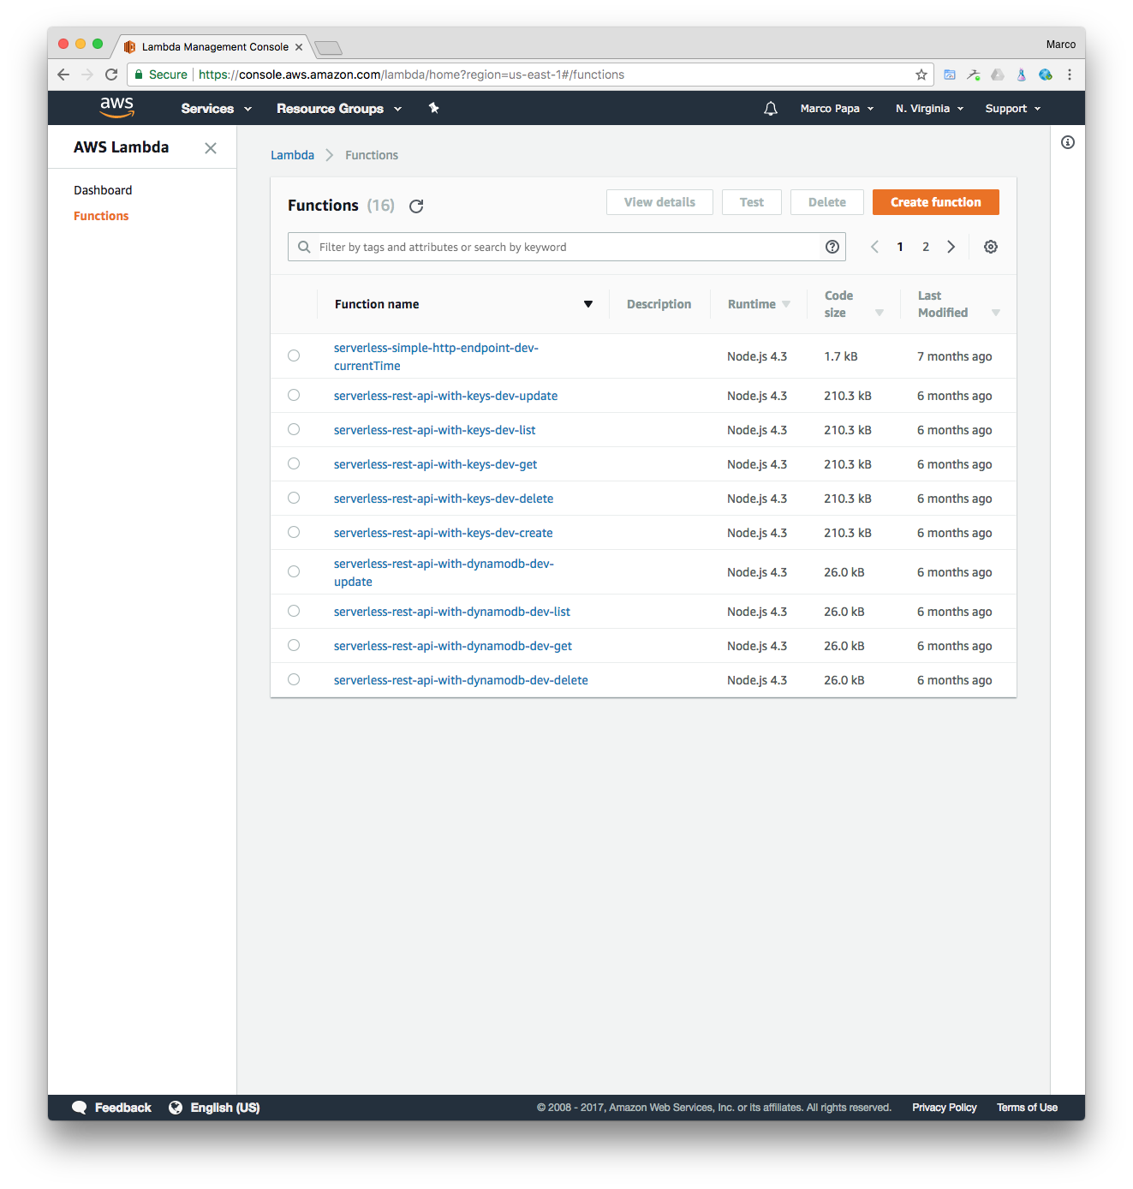
AWS Lambda (cont’d)
Choose Create function.

Slide 36
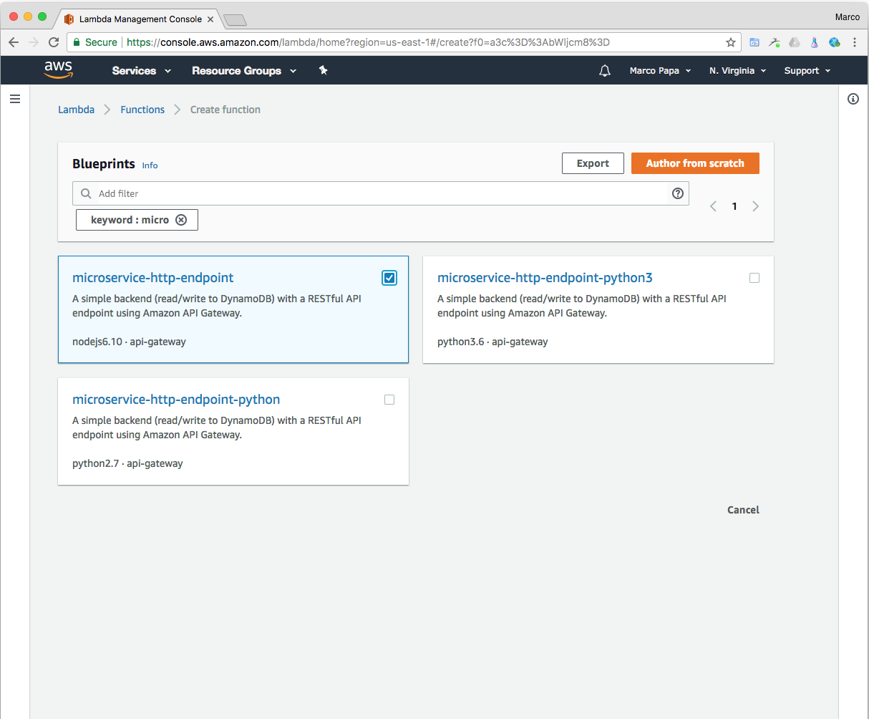
AWS Lambda (cont’d)
3. On the Blueprints page, choose the microservice-http-endpoint blueprint. You can use the Filter to find it. Just type “micro”. Click the microservice-http-endpoint hyperlink.

Slide 37
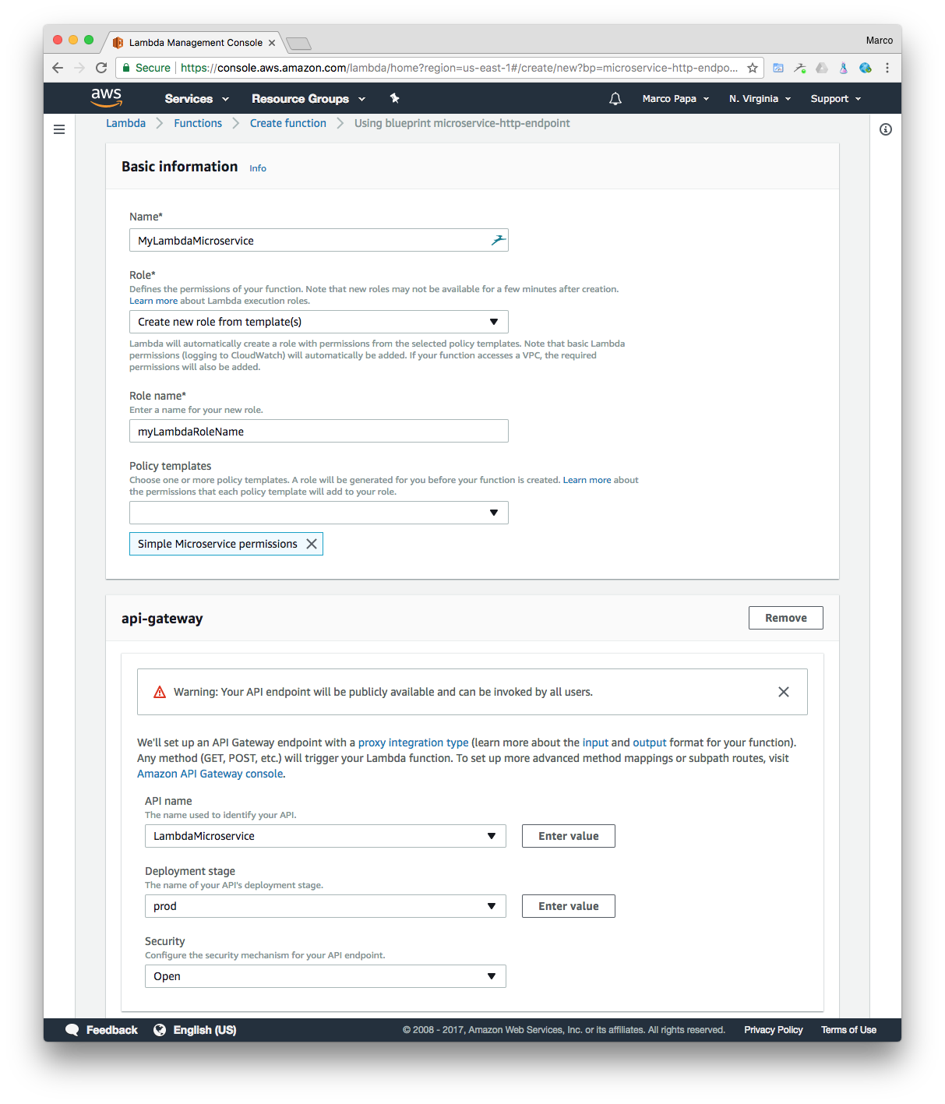
AWS Lambda (cont’d)
In the Basic information section, do the following:
Enter the function name MyLambdaMicroservice in Name.
In Role name, enter a role name for the new role that will be created, like myLambdaRoleName.
The api-gateway section will be populated with an API Gateway trigger. The default API name that will be created is LambdaMicroservice (You can change this name via the API Name field if you wish).
In the Deployment stage select prod. In the Security field, select Open, as we will be creating a publicly available REST API.

Slide 38
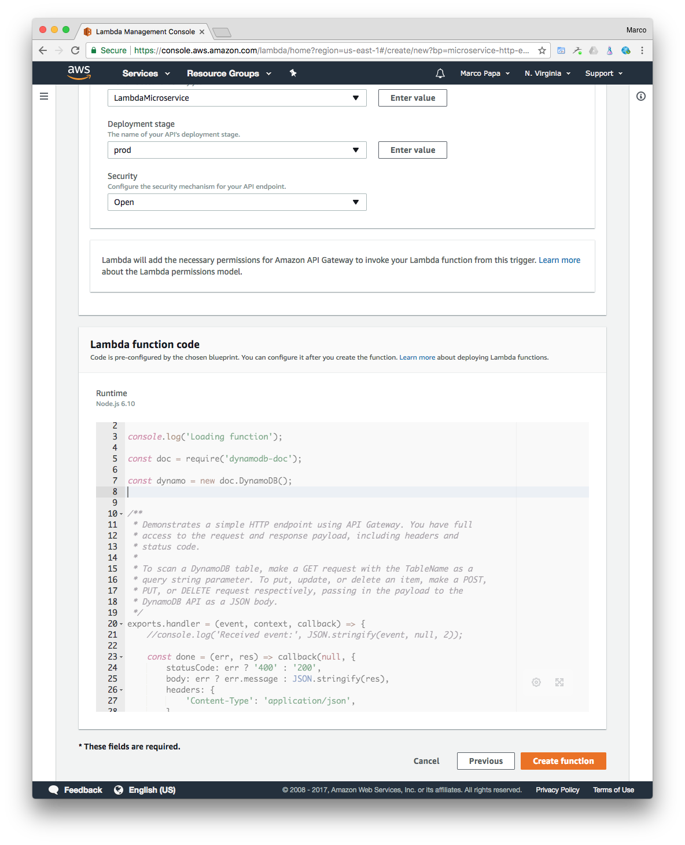
AWS Lambda (cont’d)
On the Lambda function code section, do the following:
Review the preconfigured Lambda function configuration information, including:
Runtime is Node.js 6.10
Code authored in JavaScript is provided. The code performs DynamoDB operations based on the method called and payload provided.
Chose Create function.

Slide 39
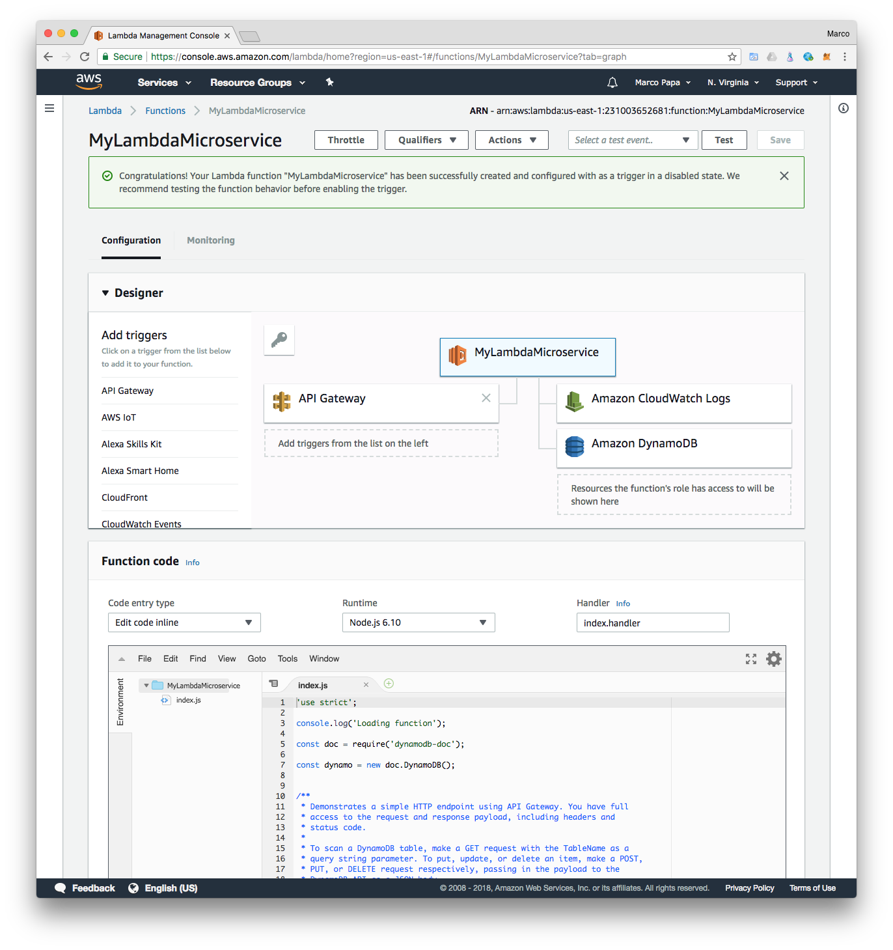
AWS Lambda (cont’d)
The “Congratulations!” page is displayed, showing the Designer tab. Notice Function Code > Handler shows index.handler. The format is: filename.handler-function

Slide 40
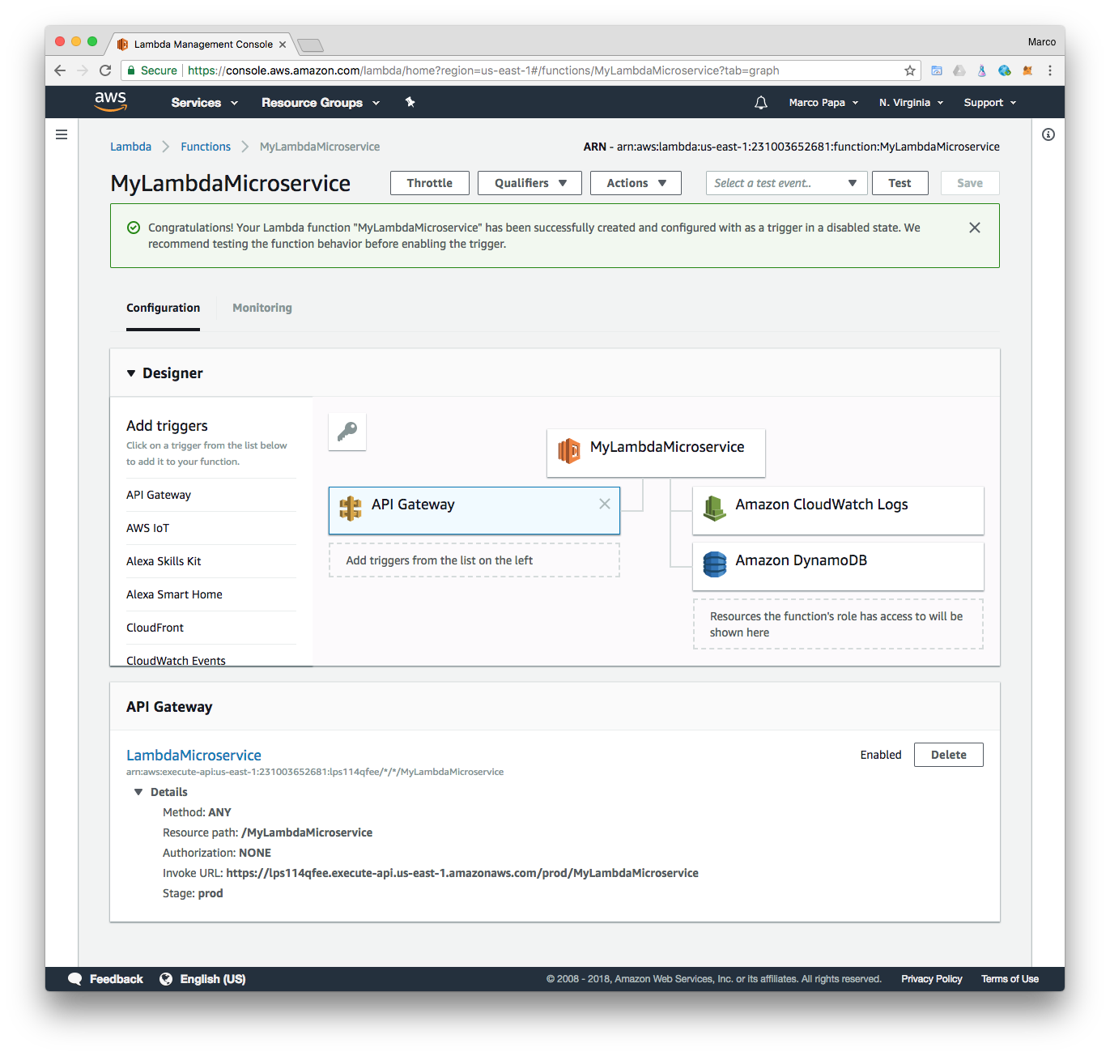
AWS Lambda (cont’d)
Click the API Gateway. Notice the Invoke URL, the HTTP REST service entry point.

Slide 41
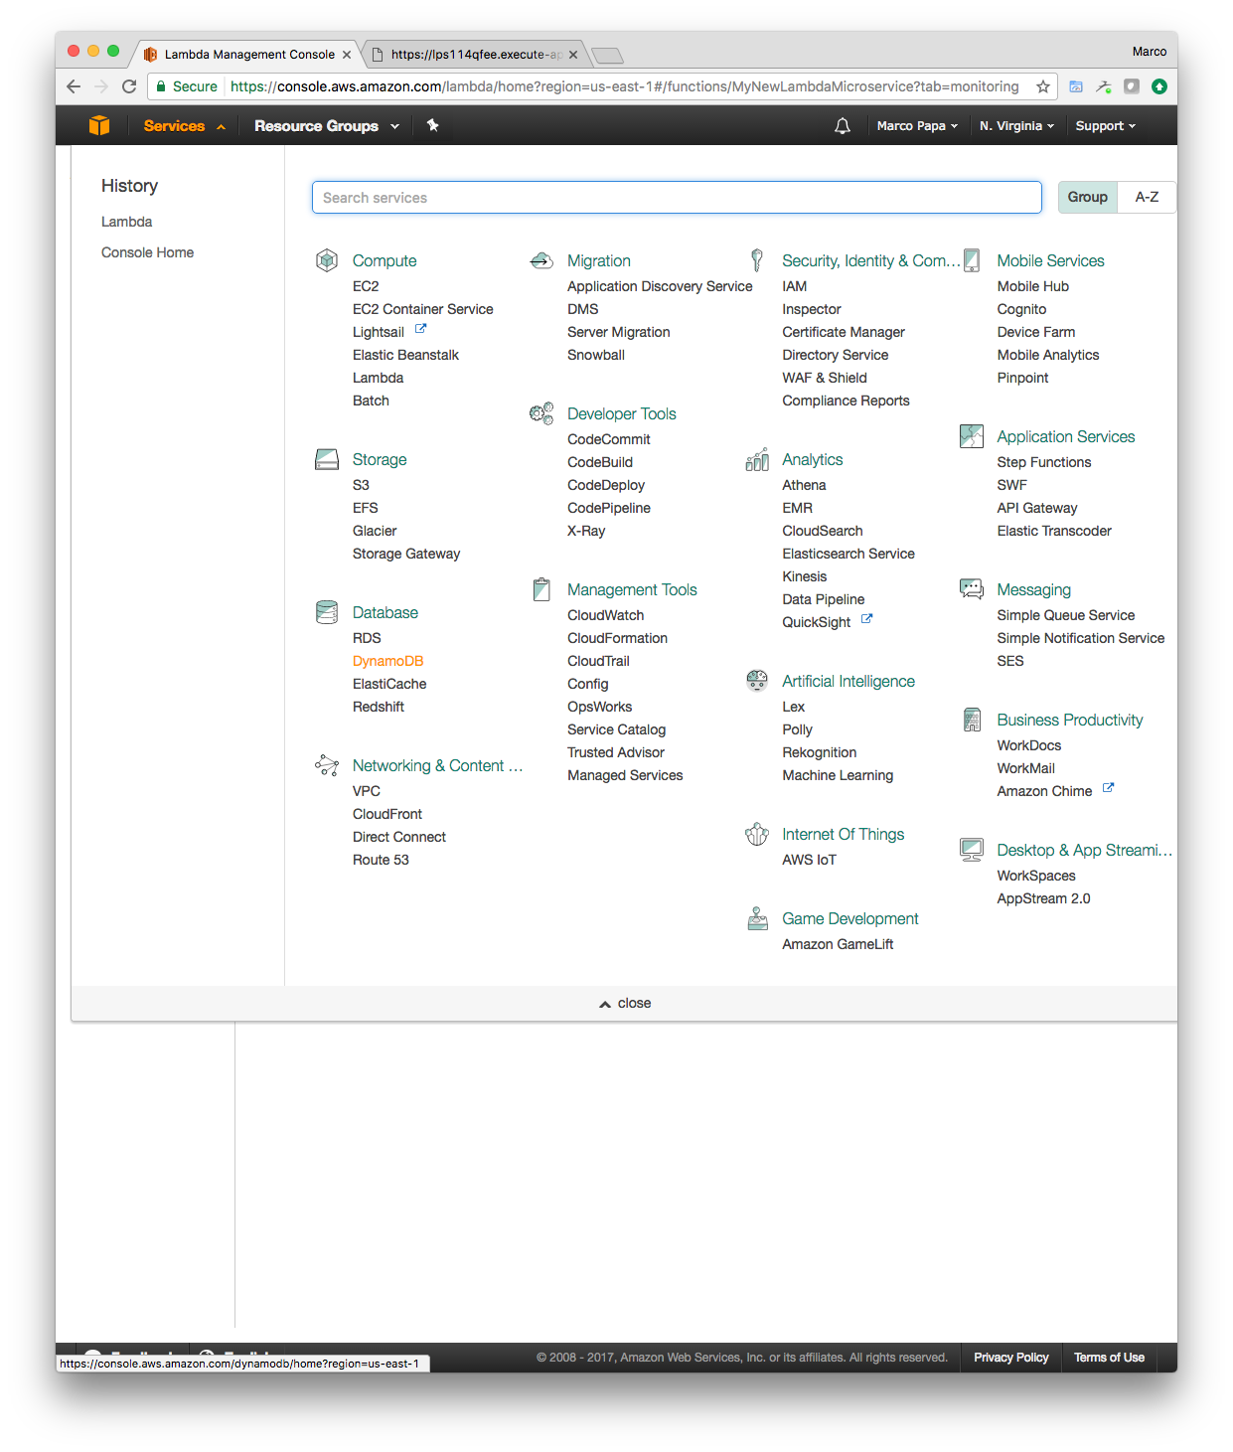
AWS Lambda (cont’d)
To test our AWS Lambda REST Service, select Database DynamoDB from the Services console.

Slide 42
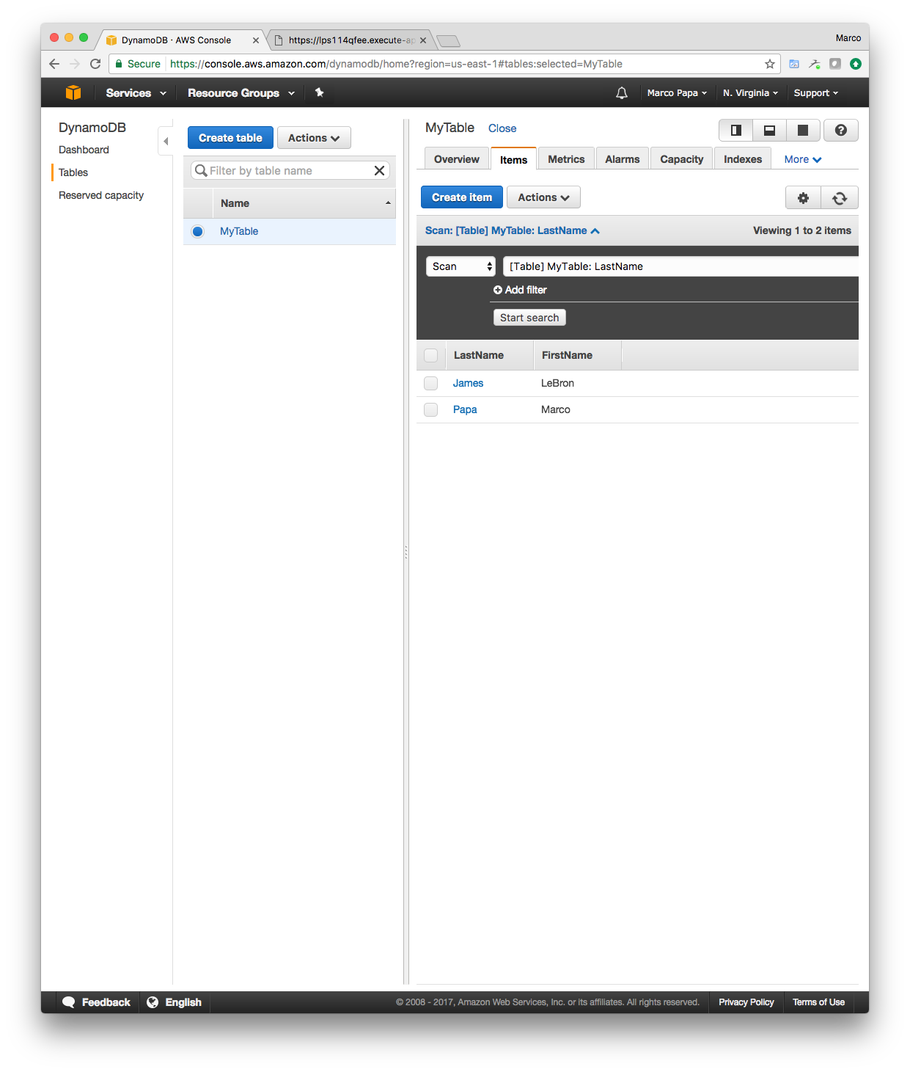
AWS Lambda (cont’d)
Create a table named MyTable, with two columns named LastName and FirstName, and enter a few rows.

Slide 43
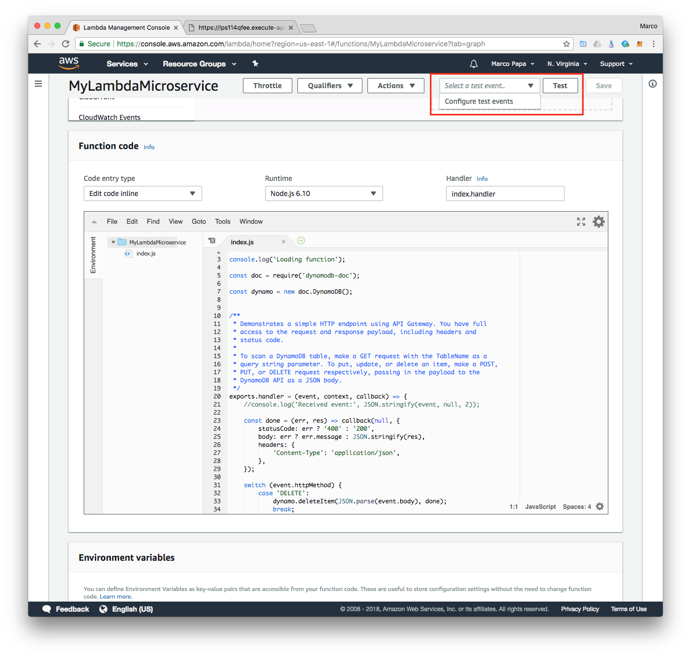
AWS Lambda (cont’d)
Back to the AWS Lambda console. In this step, we will use the console to test the Lambda function. That is, send an HTTPS request to the API method and have Amazon API Gateway invoke your Lambda function.
Select Functions from left navigation. The With the MyLambdaMicroService function still open in the console, choose the Select a test event dropdown and then choose Configure test events.

Slide 44
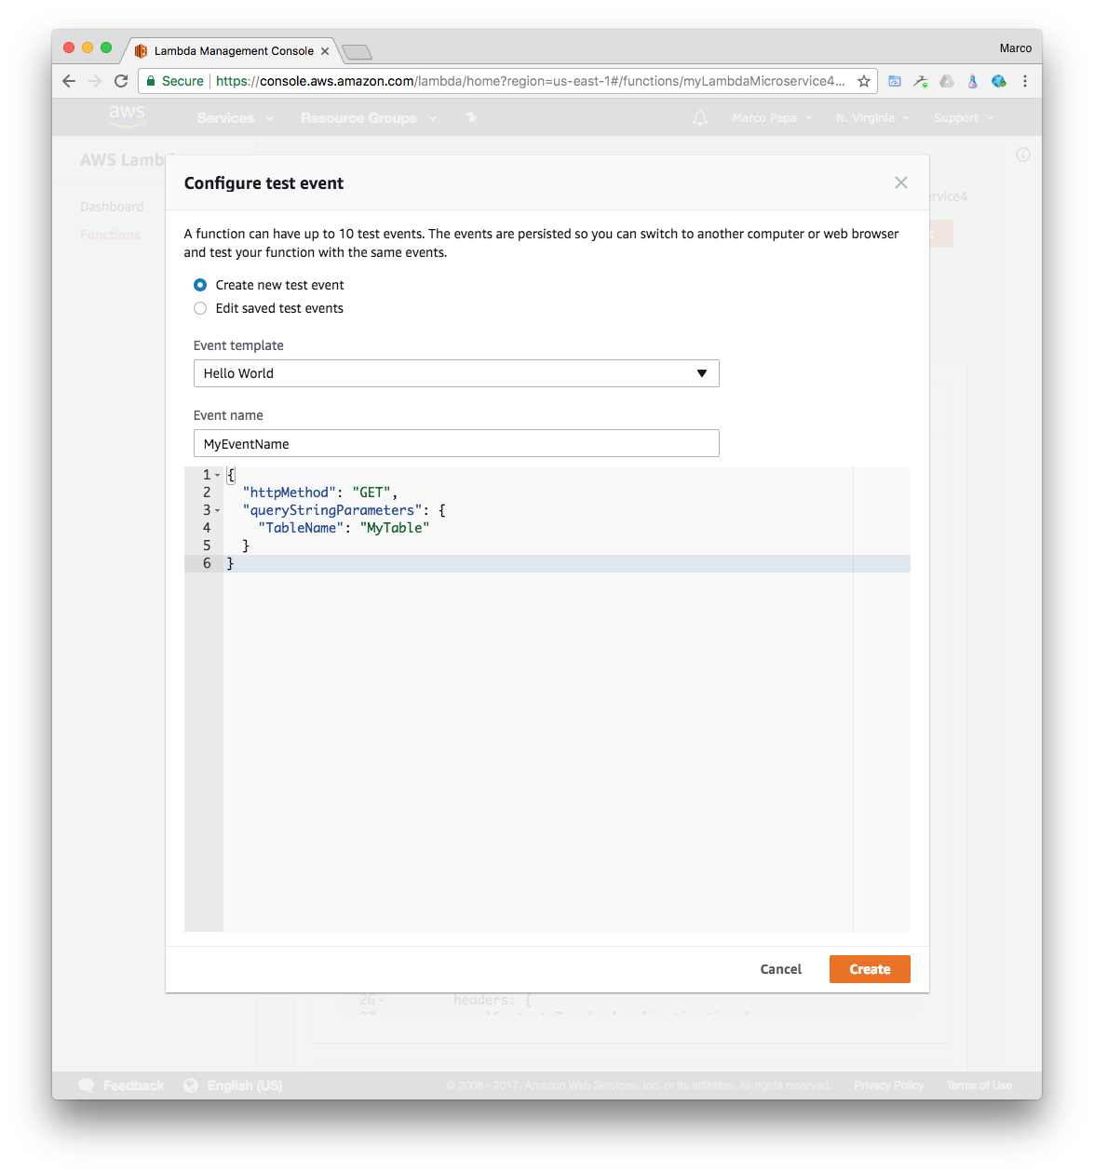
AWS Lambda (cont’d)
In the Configure test event page, select Event template “Hello World” and enter an Event Name such as MyEventName. Replace the existing text with the following:
{
"httpMethod": "GET",
"queryStringParameters": {
"TableName": "MyTable"
}
}
After “copy / paste” the text above choose Create.

Slide 45
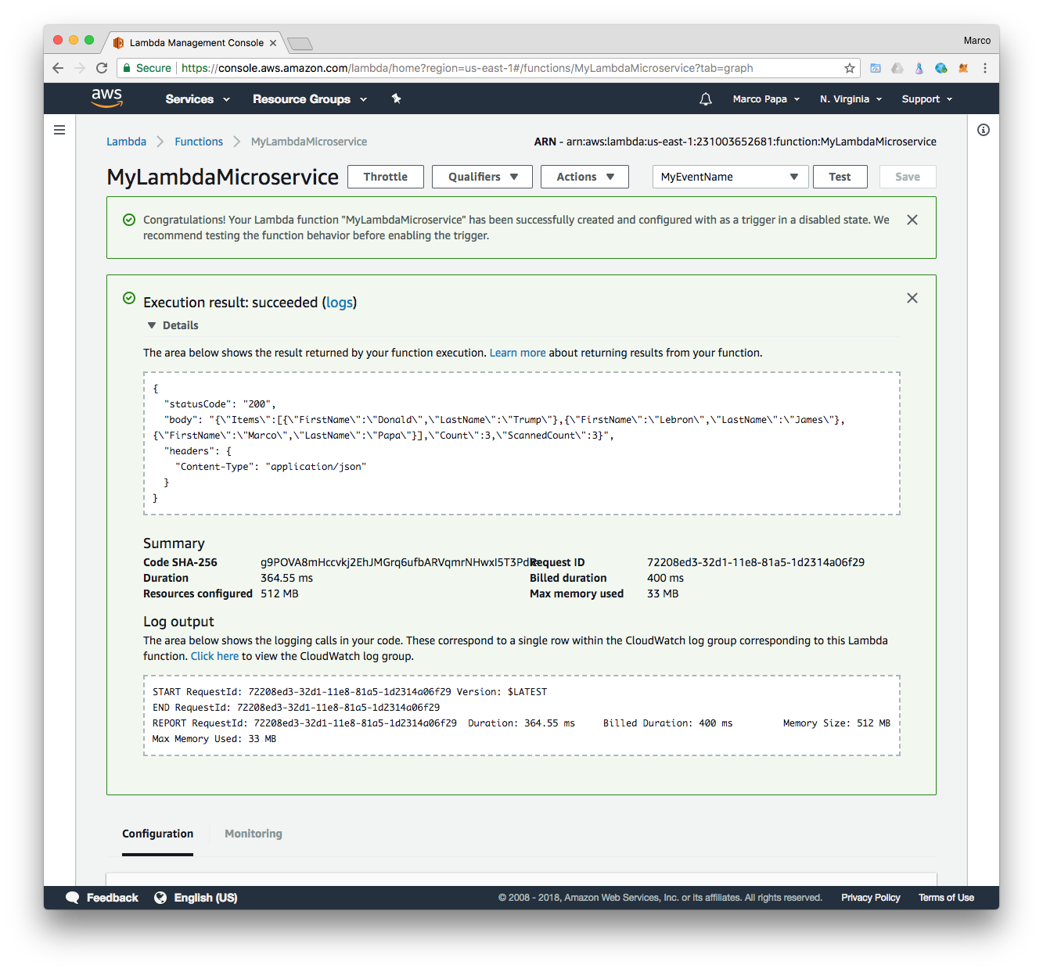
AWS Lambda (cont’d)
Click Test. Check the Execution result output, by clicking Details. Notice the JSON returned with the table content (GET scans or “lists” the items in the table).

Slide 46
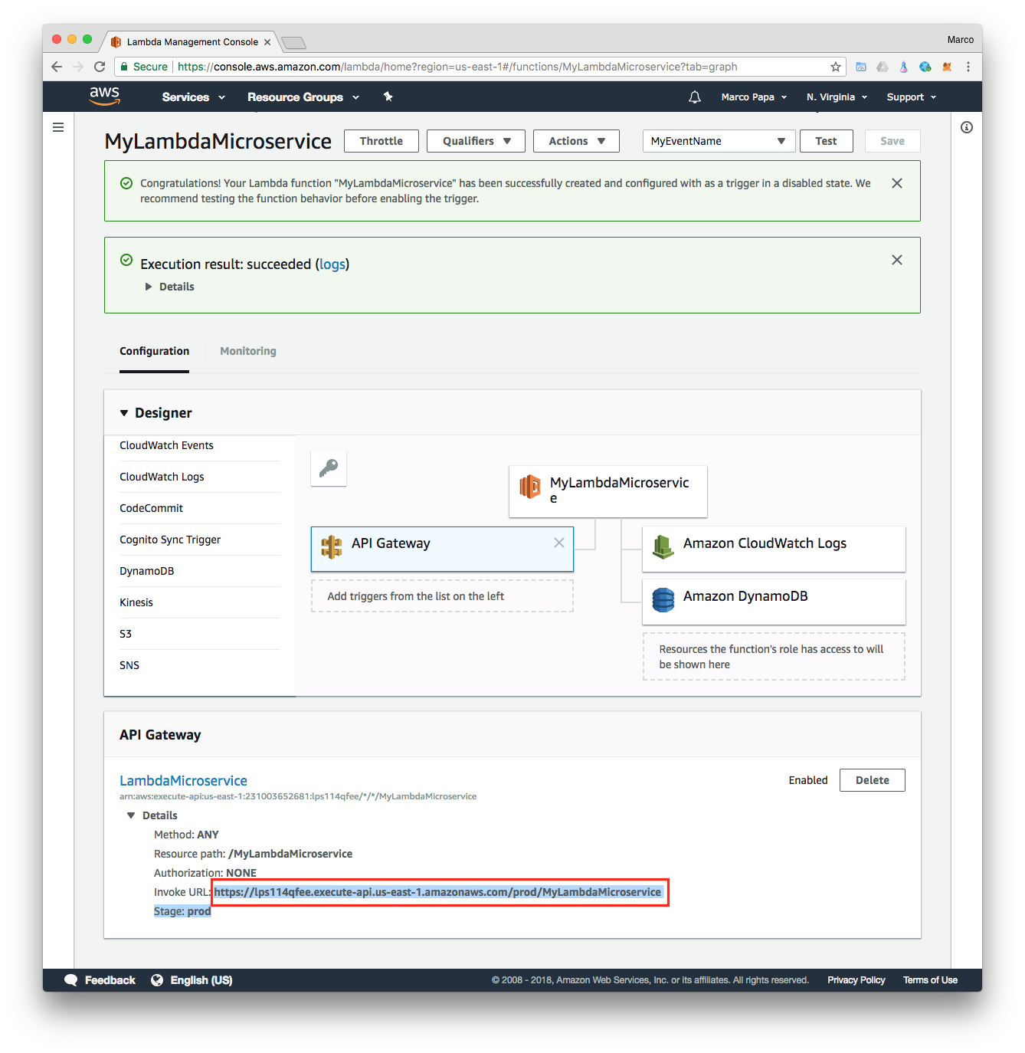
AWS Lambda (cont’d)
Click the API Gateway. Click the arrow next to Method: ANY. Notice the value of Invoke URL. This is the entry point of the API Gateway for your new microservice.

Slide 47
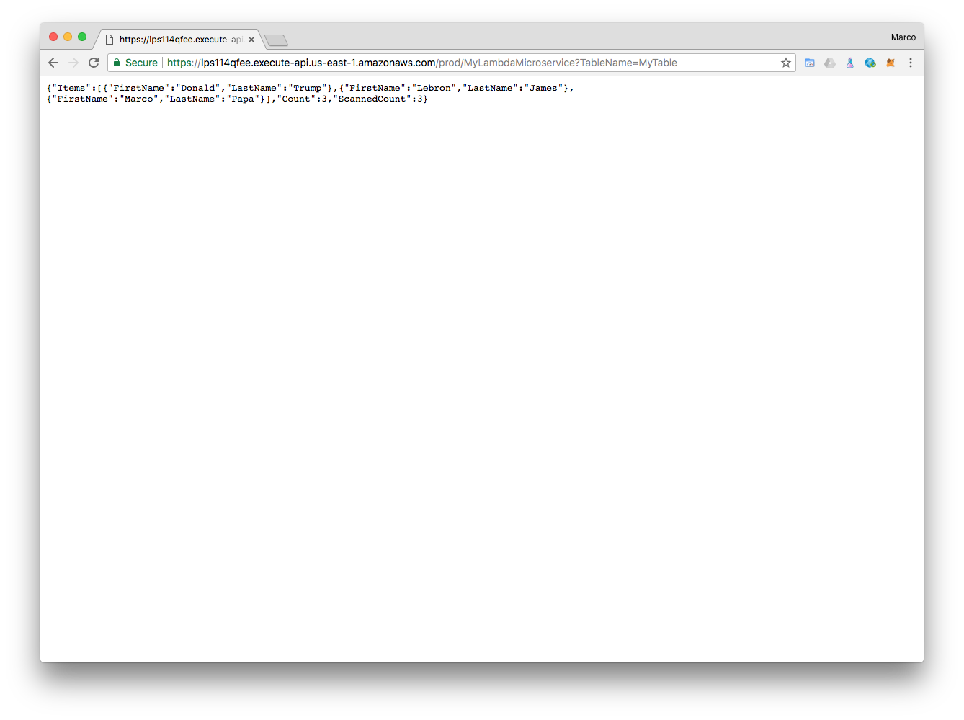
AWS Lambda (cont’d)
You can now execute the REST API from your browser as in:
https://lps114qfee.execute-api.us-east-1.amazonaws.com/prod/MyLambdaMicroservice?TableName=MyTable

Slide 48
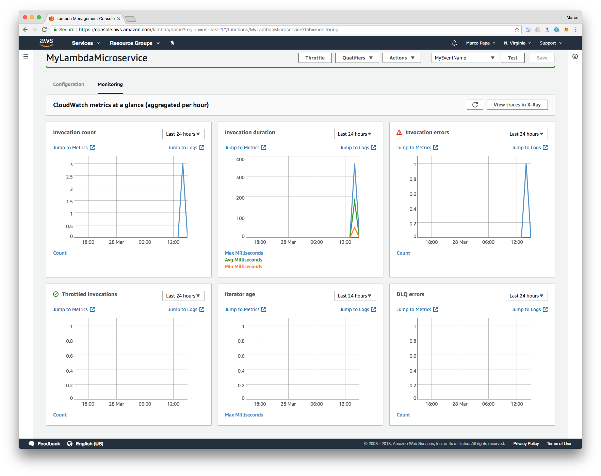
AWS Lambda (cont’d)
Check out the Monitoring tab for CloudWatch metrics.

